Slide 1
CNT4007C: Theory and Fundamentals of Computer Networks
Networking Media / Signal Encoding
Content derived from various sources including Tomsho et al., Guide to Networking Essentials,
Kurose and Ross, Computer Networking: A Top-Down Approach

Slide 2
Overview of Networking Media
Network Cables in LANs and WANs
types of networking cables
characteristics of networking cables
Wireless Networks in LANs and WANs.
Signal Encoding in LANs.

Slide 3
Media Requirements
Different wired and wireless technology exists but what determines the type of media?
Layout of space and devices connecting to network.
Distance and type of cable (wired network):
How far are connecting networking devices apart?
How much bandwidth is needed?
…
Location and number of access points (wireless network):
How far should the wireless network reach?
…

Slide 4
Cable Characteristics
Bandwidth: capacity for transporting data.
Maximum segment length: length of cable before the signal becomes too weak and distorted.
Maximum number of segments: number of segments between sender and receiver.
Hub/Switch/Router
Hub/Switch/Router
Hub/Switch/Router

Slide 5
Cable Characteristics (cont.)
Interference susceptibility: interference from outside may generate noise.
Maximum number of devices per segment: each connected device may weaken the signal (bus topology).
Material and installation cost: expensive of cable and its installation.
…

Slide 6
Primary Cable Types
Cable provide a medium for transporting signals:
Signal type may be light pulses or electrical.
Cable types include
Coaxial cable
Twisted pair cable
Fiber optic cable

Slide 7
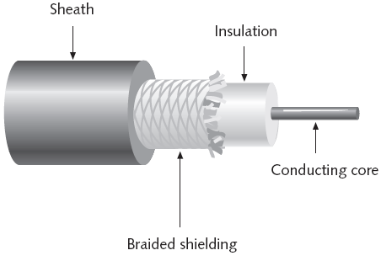
Coaxial Cable
Was predominantly used in early Ethernet.
Has protective shield to protect against interference.
Less susceptible to attenuation than twisted pair.
Higher cost than twisted pair.

Slide 8
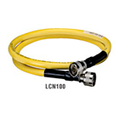
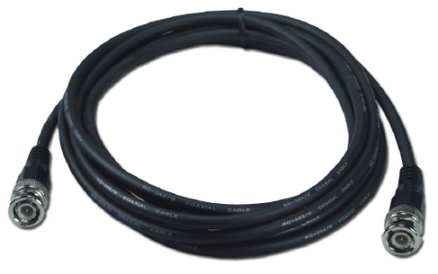
Applications of Coaxial Cables
Early Ethernet for baseband transmission:
Thicknet (10Base5): strong coaxial cable with up to 500 meters in segment length and 10 Mbps bandwidth.
Thinnet (10Base2): thinner coaxial cable with up to 185 meters in segment length and 10 Mbps bandwidth.
Broadband transmission of video/audio signal and data to customers.
enables customers to receive TV signal and Internet data
thicknet
thinnet

Slide 9
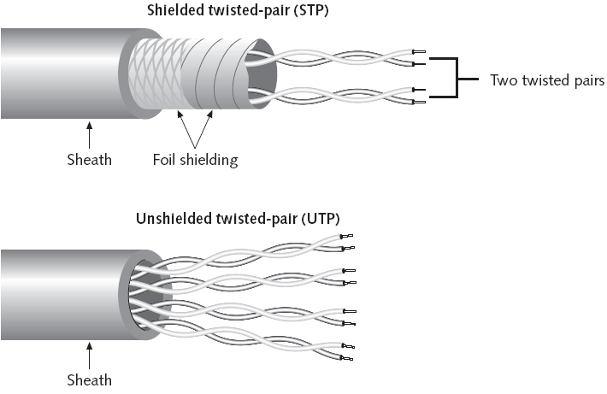
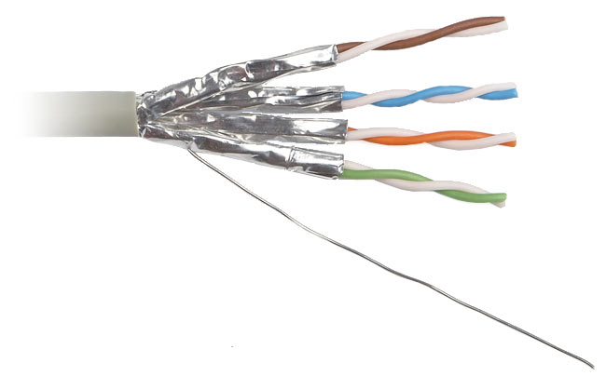
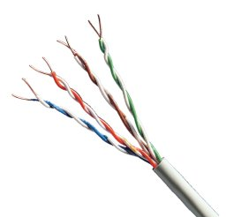
Twisted Pair Cable
STP
UTP
Unshielded Twisted-Pair (10BaseT, 100BaseT, 1000BaseT) used widely in LANs.
Shielded Twisted-Pair may be also used in LANs.
shielding reduces cross-talk and interference

Slide 10
UTP Cable Categories
Cables rated based ANSI/TIA/EIA Standard (1991).
American National Standard Institute
Telecommunications Industries Association (TIA)
Electronic Industries Alliance (EIA)
Category | Bandwidth Specifications | Application
Cat. 1 | voice only | telephone cabling
Cat. 2 | up to 4 Mbps | not used any longer
Cat. 3 | up to 10 Mbps (16 MHz) | 10BaseT, 4 Mbps token ring, …
Cat. 4 | up to 16 Mbps (20 MHz) | 10BaseT, 16 Mbps token ring, …
Cat. 5 | up to 100 Mbps (100 MHz) | 100BaseT, ATM, token ring, ..
Cat. 5e | up to 1000 Mbps (100 MHz) | 1000BaseT (Gigabit Ethernet), …
Cat. 6 | up to 1000 Mbps (200 MHz) | 1000BaseT (Gigabit Ethernet), …

Slide 11
UTP Cable Characteristics
Cat 5, 5e, 6 Characteristics | Description
Maximum cable length | 100 m (328 ft.)
Bandwidth | up to 1000 Mbps
Signaling rates | 100 MHz for Cat. 5 and 5e, 200 MHz for Cat. 6
Material | three twists per inch of each twisted pair of 24 gauge copper wires for Cat. 5 and 5e; more twists per inch for Cat. 6
Connector type | RJ-45 for device and wall-plates
Cost | Least expensive of all cabling options
Security | Moderately susceptible to eavesdropping
Interference rating | low; most susceptible of all electric cable types
Installation | easy to install and maintain

Slide 12
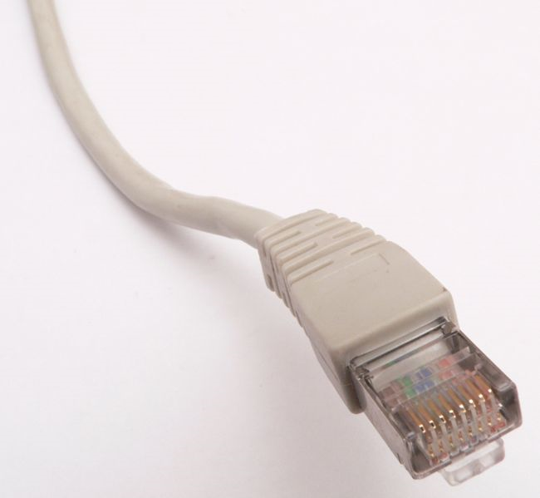
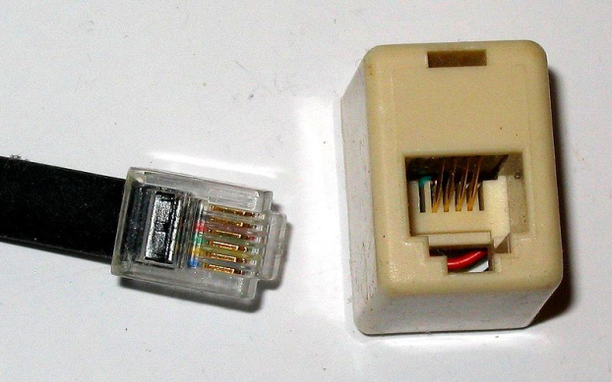
UTP Cable Connector
Cat5, Cat5e, Cat6 connectors for LAN
Cat1(Telephone line)
RJ-45 (Registered Jack)
RJ-11 (Registered Jack)

Slide 13
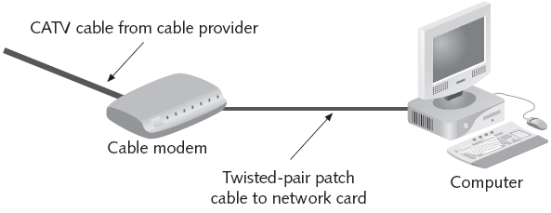
Applications of Coaxial & Twisted-Pair Cable
Coaxial cable from Cable TV provider
UTP patch cable connecting network card with cable modem

Slide 14
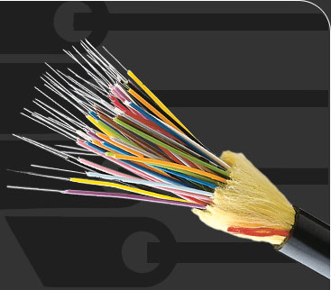
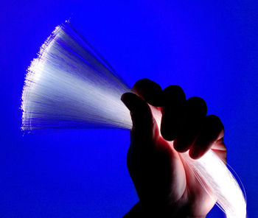
Fiber Optic Cable
inner sheath
outer sheath
kevlar for strengthening cable
optical fiber (glass or plastic)

Slide 15
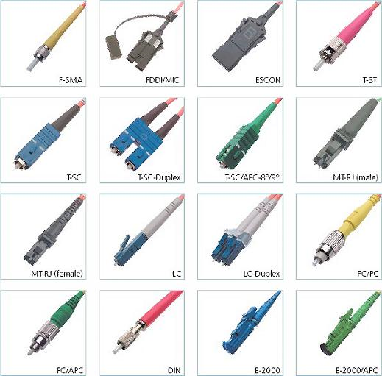
Fiber Cable Connectors
Connectors are more expensive than copper wire connectors such as RJ-45 and RJ-11.

Slide 16
Fiber Cable Characteristics
Characteristic | Description
Maximum cable length | 2 km to 100 km
Bandwidth | 10 Gbps and higher
Material | glass or plastic fiber, plastic sheath, kevlar
Connector type | several types (previous slide)
Cost | most expensive cabling option
Security | not susceptible to eavesdropping
Interference rating | none; least susceptible of all cabling options
Installation | expensive to install and maintain

Slide 17
Fiber Cable Types
Single-mode:
higher cost than multimode
generally works with laser-based emitters,
spans longer distances than multimode
bandwidth of up to 50 Gbps for up to 100 km
Multimode:
less expensive than single-mode
works with light emitting diodes (LEDs)
spans shorter distances
bandwidth of 100 Mbps to 10 Gbps depending on distance (hundreds of meters)
light source
photodiode
single ray
small
diameter
fiber
light source
photodiode
multiple rays
larger
diameter
fiber

Slide 18
Cabling Summary
Type | Maximum Cable Length | Bandwidth | Installation | Interference | Cost
UTP | 100 m | 10-1000 Mbps | Easy | High | Cheapest
STP | 100 m | 16-1000 Mbps | Moderate | Moderate | Moderate
10Base2 | 185 m | 10 Mbps | Easy | Moderate | Cheap
10Base5 | 500 m | 10 Mbps | Hard | Low | Expensive
Fiber-optic | 2-100 km | 100 Mbps – 40 Gbps | Moderate | None | Most Expensive

Slide 19
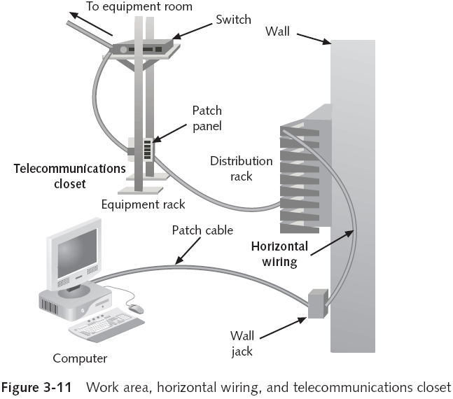
Building Wiring Layout
Equipment room houses
servers and routers.
wireless access point
backbone cabling
to other floors, wings, or
adjacent buildings

Slide 20
Building Wiring Specifications
Patch cable in work area:
wiring types include UTP cat. 5 or cat. 5e
no more than 6 m long between computer and wall jack
Horizontal wiring:
runs from the office to the telecommunication closet on same floor
wiring types include four-pair UTP (Category 5e or 6) or two fiber-optic cables
distance from the wall jack to the patch panel should be no longer than 90 meters

Slide 21
Building Wiring Specifications (cont.)
Backbone wiring:
runs between floors or wings of a building and adjacent buildings
usually fiber-optic cable
may be UTP for short distances between floors and wings of a building
distance between equipment room and main cross-connect may be up to 1500 m

Slide 22
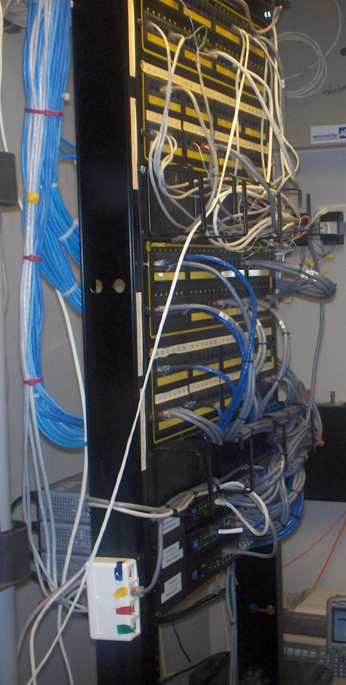
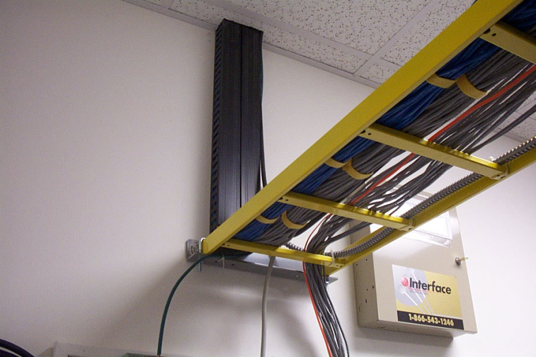
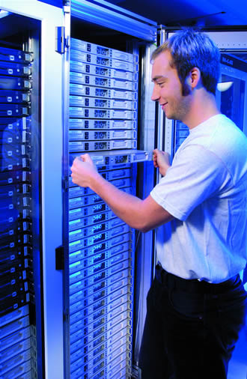
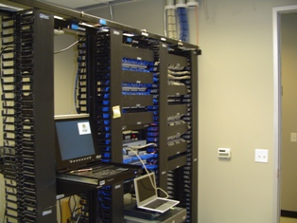
Building Wiring - Examples
server room
patch panel and switches
telecommunication room

Slide 23
Wireless Networking

Slide 24
Elements of a wireless network
wireless hosts
laptop, desktop, PDA, printer, …
may be stationary (desktop) or mobile (laptop)
Wireless does not always mean mobility.
network
infrastructure

Slide 25
Types of Wireless Network
Wireless local area network (WLAN)
easy to setup and maintain
provides ad-hoc network access in buildings
requires wireless network card and access point device
access point translates radio to electrical signal and vice-versa
Extended wireless LANs
moderately difficult to setup and maintain
provides more coverage beyond a typical LAN configuration
higher equipment cost than WLAN
Mobile computing
uses cell-phone technology for data transfer
provides ad-hoc network access anywhere within reach of a radio tower

Slide 26
Wireless Networking Benefits
Users can create temporary connections to existing wired networks.
Allows easy setup of separate subnet with different security profile.
Provides backup or contingency connectivity for existing wired networks.
Extend a network’s span beyond the reach of wire-based or fiber-optic cabling
attractive for buildings were wiring would be too expensive or impractical
Enable users to roam with their machines within certain limits (called “mobile networking”)

Slide 27
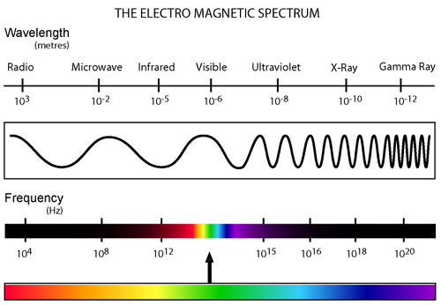
Wireless LAN Transmission
Uses electromagnetic waves for data transmission.
Frequency of the wave forms is measured in Hz.
low frequency waves carry data slower over longer distances than high frequency waves
low frequency waves emit less energy than high frequency waves
Spectrum of electromagnetic waves for data transmission is divided into three ranges:
Radio: 10 KHz to 1 GHz
Microwave: 1 GHz to 500 GHz
Infrared: 500 GHz to 1 THz

Slide 28
IEEE 802.11 Wireless LAN (WiFi)
Is an extension of the Ethernet using airwaves.
Uses same protocol as wired Ethernet
WiFi hot spot can be directly connected to hub, switch or a router
Includes several standards for wireless data transmission:
Standard | Frequency Range | Data Rate
802.11b | 2.4 – 2.5 GHz | up to 11 Mbps
802.11a | 5.1 – 5.8 GHz | up to 54 Mbps
802.11g | 2.4 – 2.5 GHz | up to 54 Mbps
802.11n | 2.4 – 2.5 GHz | 54 Mbps – 200 Mbps

Slide 29
IEEE 802.11b/g Wireless LAN (WiFi) Configuration
Access point (AP) must be assigned a channel name and number.
Each access point is given a MAC address
85 MHz band (2.4-2.485) can be divided into 11 channels of partially overlapping spectrum of airwaves
channels separate different APs for better wireless access

Slide 30
Characteristics of selected wireless link standards
200
802.11n
54
802.11a,g
802.11a,g point-to-point
data
5-11
802.11b
802.16 (WiMAX)
4
UMTS/WCDMA-HSPDA, CDMA2000-1xEVDO
3G cellular
enhanced
Data rate (Mbps)
1
802.15
.384
UMTS/WCDMA, CDMA2000
3G
.056
IS-95, CDMA, GSM
2G
Indoor
10-30m
Outdoor
50-200m
Mid-range
outdoor
200m – 4 Km
Long-range
outdoor
5Km – 20 Km

Slide 31


Wireless network characteristics
Multiple wireless senders and receivers create additional problems (beyond multiple access):
A
B
C
C
A’s signal
strength
C’s signal
strength
B
A
Hidden terminal problem
B, A hear each other
B, C hear each other
A, C can not hear each other means A, C unaware of their interference at B
space
Signal attenuation:
B, A hear each other
B, C hear each other
A, C can not hear each other interfering at B

Slide 32
Code Division Multiple Access (CDMA)
unique “code” assigned to each user; i.e., code set partitioning
all users share same frequency, but each user has own “chipping” sequence (i.e., code) to encode data
allows multiple users to “coexist” and transmit simultaneously with minimal interference (if codes are “orthogonal”)
encoded signal = (original data) X (chipping sequence)
decoding: inner-product of encoded signal and chipping sequence

Slide 33
CDMA encode/decode
channel output Z_{i,m}
Z_{i,m}= d_{i}.c_{m}
data
bits
d₀ = 1
1
1
1
1
1
d₁ = -1
1
1
1
-
-
-
-
1
-
-
-
1
-
1
1
1
1
1
sender
1
1
slot 1
channel
output
slot 0
channel
output
1
1
1
1
1
code
1
1
-
-
-
1
-
1
1
1
-
-
-
1
-
1
1
1
slot 1
slot 0
M
D_{i} = Σ Z_{i,m}.c_{m}
m=1
M
received
input
1
1
1
1
1
1
1
1
d₀ = 1
-
-
-
-
1
-
-
-
1
-
1
1
1
1
1
1
d₁ = -1
1
slot 1
channel
output
slot 0
channel
output
1
1
1
1
1
code
1
1
-
-
-
1
-
1
1
1
-
-
-
1
-
1
1
1
receiver
slot 1
slot 0

Slide 34
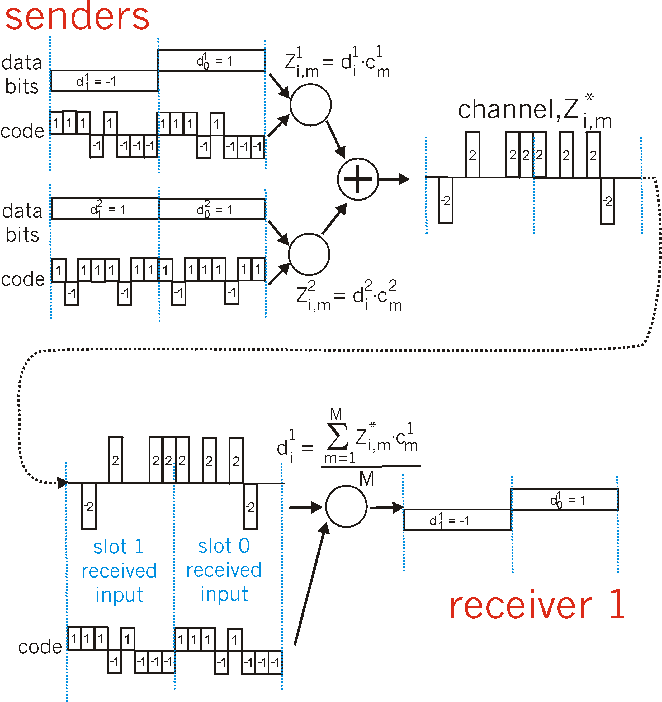
CDMA: two-sender interference
channel sums together transmissions by sender 1 and 2
Sender 1
Sender 2
using same code as sender 1, receiver recovers sender 1’s original data from summed channel data!

Slide 35
IEEE 802.11 Wireless LAN
802.11b
2.4-5 GHz unlicensed spectrum
up to 11 Mbps
direct sequence spread spectrum (DSSS) in physical layer
all hosts use same chipping code
802.11a
5-6 GHz range
up to 54 Mbps
802.11g
2.4-5 GHz range
up to 54 Mbps
802.11n: multiple antennae
2.4-5 GHz range
up to 200 Mbps
all use CSMA/CA for multiple access
all have base-station and ad-hoc network versions

Slide 36


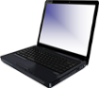


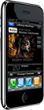
802.11 LAN architecture
wireless host communicates with base station
base station = access point (AP)
Basic Service Set (BSS) (aka “cell”) in infrastructure mode contains:
wireless hosts
access point (AP): base station
ad hoc mode: hosts only
Internet
hub, switch
or router
BSS 1
BSS 2

Slide 37
802.11: passive/active scanning
BBS 1
BBS 2
BBS 1
BBS 2
1
AP 2
AP 1
1
1
AP 2
AP 1
2
2
2
3
3
4
H1
H1
passive scanning:
beacon frames sent from APs
association Request frame sent: H1 to selected AP
association Response frame sent from selected AP to H1
active scanning:
Probe Request frame broadcast from H1
Probe Response frames sent from APs
Association Request frame sent: H1 to selected AP
Association Response frame sent from selected AP to H1

Slide 38




IEEE 802.11: multiple access
avoid collisions: 2⁺ nodes transmitting at same time
802.11: CSMA - sense before transmitting
don’t collide with ongoing transmission by other node
802.11: no collision detection!
difficult to receive (sense collisions) when transmitting due to weak received signals (fading)
can’t sense all collisions in any case: hidden terminal, fading
goal: avoid collisions: CSMA/C(ollision)A(voidance)
A
B
C
C
B
A’s signal
strength
C’s signal
strength
A
space

Slide 39
IEEE 802.11 MAC Protocol: CSMA/CA
802.11 sender
1 if sense channel idle for DIFS then
transmit entire frame (no CD)
2 if sense channel busy then
start random backoff time
timer counts down while channel idle
transmit when timer expires
if no ACK, increase random backoff interval, repeat 2
802.11 receiver
- if frame received OK
return ACK after SIFS (ACK needed due to hidden terminal problem)
sender
receiver
DIFS
data
SIFS
ACK

Slide 40
Avoiding collisions (more)
idea: allow sender to “reserve” channel rather than random access of data frames: avoid collisions of long data frames
sender first transmits small request-to-send (RTS) packets to BS using CSMA
RTSs may still collide with each other (but they’re short)
BS broadcasts clear-to-send CTS in response to RTS
CTS heard by all nodes
sender transmits data frame
other stations defer transmissions
avoid data frame collisions completely
using small reservation packets!

Slide 41


Collision Avoidance: RTS-CTS exchange
A
B
AP
RTS(B)
RTS(A)
reservation collision
RTS(A)
CTS(A)
CTS(A)
DATA (A)
defer
time
ACK(A)
ACK(A)

Slide 42
Signal Encoding in Wired Media

Slide 43
Types of Signal Transmissions
Broadband transmission
transmission over a broad spectrum of frequencies
use analog techniques to encode binary 1s and 0s across a continuous range of values
Baseband transmission
signals take the form of discrete pulses of electricity or light
uses a digital encoding scheme (line coding) at a single fixed frequency

Slide 44
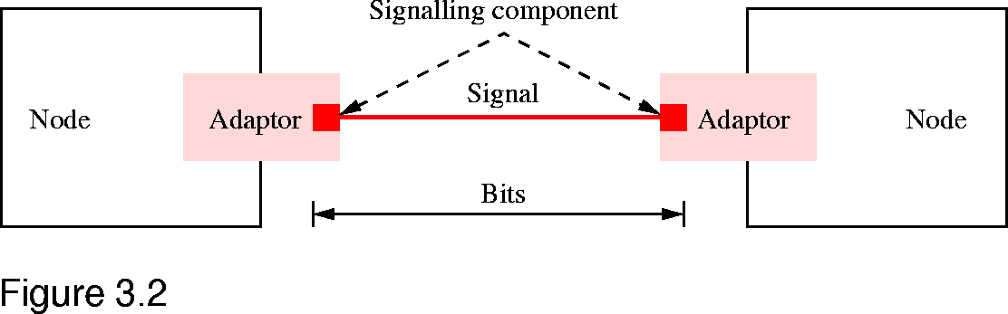
Encoding Schemes in Media (Physical Layer)
What is Encoding?
Encoding addresses how binary data is converted into these signals.
Typically implemented in a signaling component (transceiver) that is part of the network interface

Slide 45
Baseband Transmission
Digital/Baseband Channel
1 0 0 1 1
Line Coding Encoder
Line Coding Decoder
1 0 0 1 1
Apply pulse modulation to binary symbol for transmission over digital/baseband channel.
Pulse modulation uses regular sequence of pulses to encode / decode data.
Line coding examples: Alternate Mark Inversion (AMI), Manchester, …

Slide 46
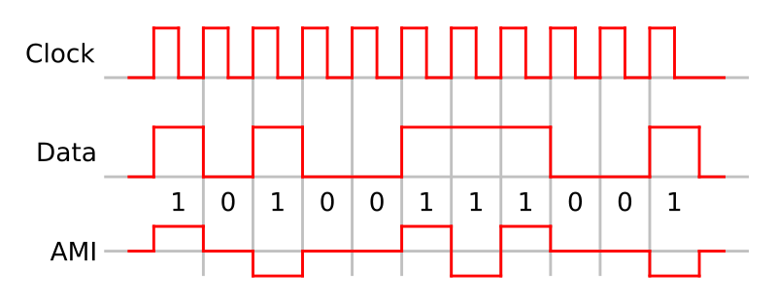
Alternative Mark Inversion (AMI)
0 are encoded as 0 volt, 1 is encoded as alternate positive or negative volt.
Problems: long sequence of 0 may cause receiver to become out of sync with sender.
Image from Wikipedia

Slide 47
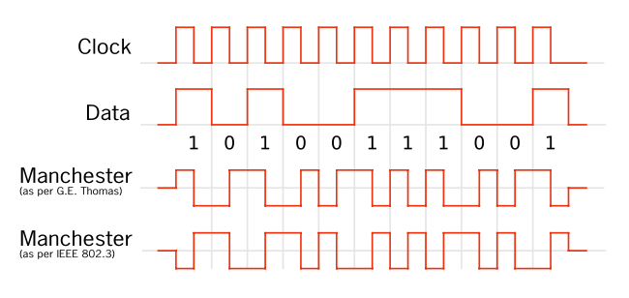
Manchester Encoding (line code)
Transmits the exclusive-OR of the clock and signal.
each bit is transmitted in a fixed time
a 1 is encoded by a transition from high to low and a 0 by a transition from low to high (G.E. Thomas convention)
Results in a transition every clock cycle.

Slide 48
Digital Modulation
Carrier
Analog Channel
1 0 0 1 1
Modulation
Demodulation
1 0 0 1 1
Uses a sine carrier wave signal to encode data.
sine carrier wave has low frequency spectrum compared to square waves
Used for transmission over long distances.
Forms of modulation:
amplitude
frequency
phase-shift

